Slide 1

“Machine learning techniques in sensor based human activity recognition and understanding human actions using still images”
Saura Elghonimi
Eduardo R
Khushboo Agarwal

Slide 2
Data sources
http://www.cis.fordham.edu/wisdm/dataset.php
Raw time series data
Number of examples
1,098,207
Number of attributes – 6
Class Distribution
Walking: 424,400 (38.6%)
Jogging: 342,177 (31.2%)
Upstairs: 122,869 (11.2%)
Downstairs: 100,427 (9.1%)
Sitting: 59,939 (5.5%)
Standing: 48,395 (4.4%)
Transformed
Number of transformed examples: 5,424
Number of transformed attributes: 46
Missing attribute values: None
Class Distribution
Walking: 2,082 (38.4%)
Jogging: 1,626 (30.0%)
Upstairs: 633 (11.7%)
Downstairs: 529 (9.8%)
Sitting: 307 (5.7%)
Standing: 247 (4.6%)
Source – give the information

Slide 3

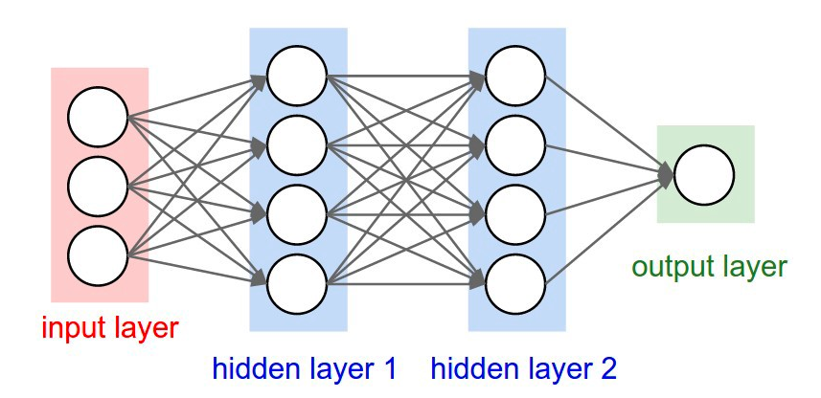
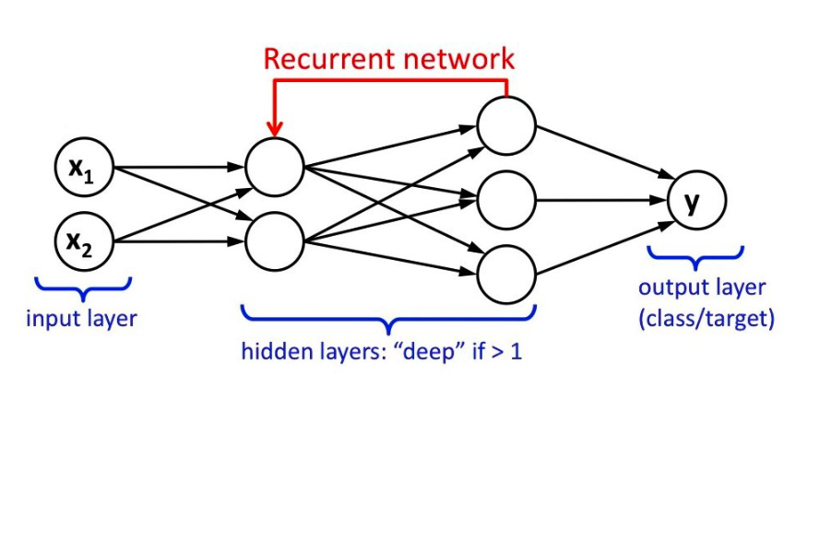
Techniques
Deep Neural Network
LSTM- Long short-term memory/Recurrent Neural Network
Deep Neural Network (DNN)
Image source-http://cs231n.github.io/neural-networks-1/
LSTM
Image source- Towards Data Science, Implementation of RNN,LSTM and GRU Chandra Churh Chatterjee

Slide 4
The algorithm –DNN

Slide 5


CITATIONS/REFERENCES 1.Activity Recognition using cellphone Accelerometers Jennifer R. Kwapisz, Gary M. Weiss, Samuel A. Moore 2. Human Activity Recognition(HAR) Tutorial with Keras and Core ML(Part 1) Nils Ackermann –Towards Data Science 3.The impact of Personalization of smartphone – Based Activity Recognition Gary M. Weiss and Jeffrey W. Lockhart 4.Human Activity Recognition using LSTMs on Android – TensorFlow for Hackers (Part 6) Venelin Valkov –Medium

